Slide 1
RETURN TO SKATING
Revised – September 2021

Slide 2
Phase 2 - Return to Skating
MANDATORY FORMS
SKATE CANADA ASSUMPTION OF RISK AND WAIVER (Must be handed in prior to stepping on the ice, only needs to be completed once)
DAILY HEALTH SCREENING CHECKLIST (to be completed at home before coming to the rink)
CONTACT TRACING LOG FOR SKATERS/COACHES/VOLUNTEERS (Daily-At Rink)

Slide 3
SESSIONS WILL BE REGISTERED THROUGH UPLIFTER
NO BUY ON’S WILL BE ALLOWED
ALL SKATERS MUST BE REGISTERED TO
BE ALLOWED ON THE ICE
All invoices must be paid in full BEFORE skater is allowed on the ice.
Only skaters on the Waitlist will be allowed to register if a spot become available.
Spectators are allowed in the bleachers only.

Slide 4
BEFORE YOU LEAVE HOME
DO NOT leave home if you are feeling unwell or showing signs of COVID-19 Symptoms (Fever, Cough, Shortness of Breath, Sore Throat or Runny Nose).
Skaters arrive ready to skate.
Eat before you come. If you take food, ensure it is self-contained and do not share.
Thoroughly wash your hands with soap and warm water.
Thoroughly wash training clothes and accessories including water bottle, phone, gloves, skates, guards, blade rag, etc.
Bring your filled water bottle from home
Bring your own personal hand sanitizer, tissues
etc.
Use the washroom

Slide 5
AT THE ARENA
Arrive at the Coke Centre no more than 15 minutes prior to your session
Skaters will be assigned a dressingroom. etc.
Respect social distancing guidelines at all times. Minimum of 3 meters apart!
Masks are mandatory at all times while at ice level except while the skaters are on the ice practicing.
Avoid touching door handles, gates, benches, and all other common surfaces.
Wash your hands and/or use hand sanitizer.
Leave the facility immediately following your
session
GET IN….TRAIN…..GET OUT!

Slide 6
All individuals taking part in club/skating school activities must self-screen at home and in accordance with Public Health Orders must not attend any training sessions or club activities if they:
Screening of individuals
Exhibit any COVID-19 symptoms, such as a fever, cough, difficulty breathing, or other symptoms identified by health experts
Have returned from travel outside of Canada (must quarantine for 14 days at home)
Have been in contact with someone with COVID-19 in the past 14 days

Slide 7
Personal Protective Equipment (PPE)
Coaches are required to wear a non- medical face mask or a face shield at all times.
Masks are mandatory for all individuals.
Congregating in groups inside or outside the arena is not recommended.
Any individual attending to a non-family member for a medical emergency must wear appropriate PPE including a medical face mask and disposable gloves.
GPSC will provide masks and gloves and have them available at ice surface in case of a medical emergency.

Slide 8
Music / Technology / Equipment
The Coaches will be responsible for the use of the music equipment. It will be cleaned between each use. Coaches may play music using Bluetooth technology.
Harnesses are allowed under supervision.

Slide 9
Travel
Transportation to and from the facility should be arranged so that only individuals from the same household or cohort members share rides.
When exiting the facility after training, individuals should minimize the time spent in parking lots and maintain physical distancing when returning to vehicles or homes.
Individuals who take public transportation to the facility must immediately upon arrival wash their hands thoroughly with soap and water.

Slide 10
Club Office
The Club office will remain closed to the public.
All administrative activities will be conducted online.

Slide 11
Illness Policy
A “participant” includes a skater, coach, volunteer, or parent / spectator.
Inform an individual in a position of authority (coach, GPSC supervisor) immediately if you feel any symptoms of COVID-19 such as fever, chills, cough, shortness of breath, sore throat and painful swallowing, stuffy or runny nose, loss of sense of smell, headache, muscle aches, fatigue, and loss of appetite.
Assessment
Participants must complete the daily screening for symptoms before arrival at the facility
Supervisors/coaches will visually monitor participants to assess any early warning signs as to their health status
If Participants are unsure, they will be instructed to use the Alberta Health COVID-19 self-assessment tool
If a Participant is feeling sick with COVID-19 symptoms
They should remain at home and contact Health Link at 811
If they feel sick and/or are showing symptoms while at the facility, they will be sent home immediately and will be instructed to contact 811 or a doctor for further guidance
No Participant may participate in a session if they are symptomatic
If a Participant tests positive for COVID-19
The Participant will not be permitted to return to the facility until they are free of the COVID-19 virus as verified by a medical professional
Any Participants who practice closely with the infected participant will also be removed from the facility for at least
14 days to ensure the infection does not spread further
If any participant tests positive, the club will inform the Alberta-NWT/Nunavut Section Office of the positive case

Slide 12
Illness Policy continued
If a Participant has been tested and is waiting for the results of a COVID-19 test
As with the confirmed case, the Participant will be removed from the facility
The Public Health Agency of Canada advises that any person who has even mild symptoms to stay home and contact Health Link at 811
Other Participants who may have been exposed will be informed and removed from practice for at least 14 days or
until the diagnosis of COVID-19 is ruled out by health authorities
If a Participant has come in to contact with someone who is confirmed to have COVID-19
Participants must advise their coach and/or the GPSC supervisor if they reasonably believe they have been exposed to COVID-19
Once the contact is confirmed, the Participant will be required to follow the direction of Alberta Health Services
Quarantine or Self-Isolate if:
Any Participant who has a member of their household who has travelled outside of Canada and has experienced any symptoms identified on the verbal health screening questionnaire within the last 14 days is not permitted to enter any part of the facility and must quarantine and self-isolate
Any Participant with any symptoms of COVID-19 is not permitted to enter any part of the facility and must quarantine and self-isolate
Any Participant from a household with someone showing symptoms of COVID-19 is not permitted to enter any part of the facility and must quarantine and self-isolate
Any Participant who is in quarantine or self-isolating as a result of contact with an infected person or in families
who are self-isolating, is not permitted to enter any part of the facility

Slide 13
First Aid
Designated Responder (Base Coach) to oversee each session and activate response plan as needed.
Coach is to be first point of contact for first aid if skater is on the ice Coach must be attired in a mask and gloves using proper protocols of donning of PPE before attending skater.
Coach moves skater to secure spot off the ice.
Coach contacts guardians and if needed Emergency responders. Coach to gather skater and their personal effects, and walk skater to meet their ride or hand off to parent.
Coach is responsible to fill out the Incident Report form on the Skate Canada website. (No paper documents) https://skatecanada.wufoo.com/forms/qrkdn w40ve6pyn

Slide 14
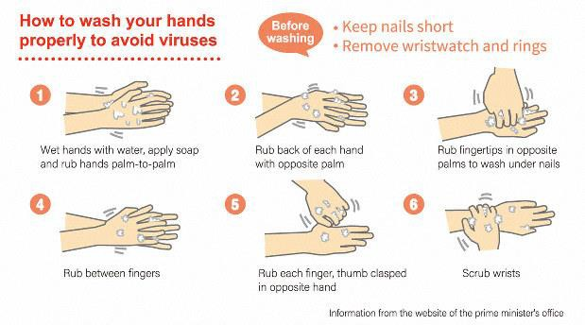
Hand Hygiene – Wash your hands often

Slide 15
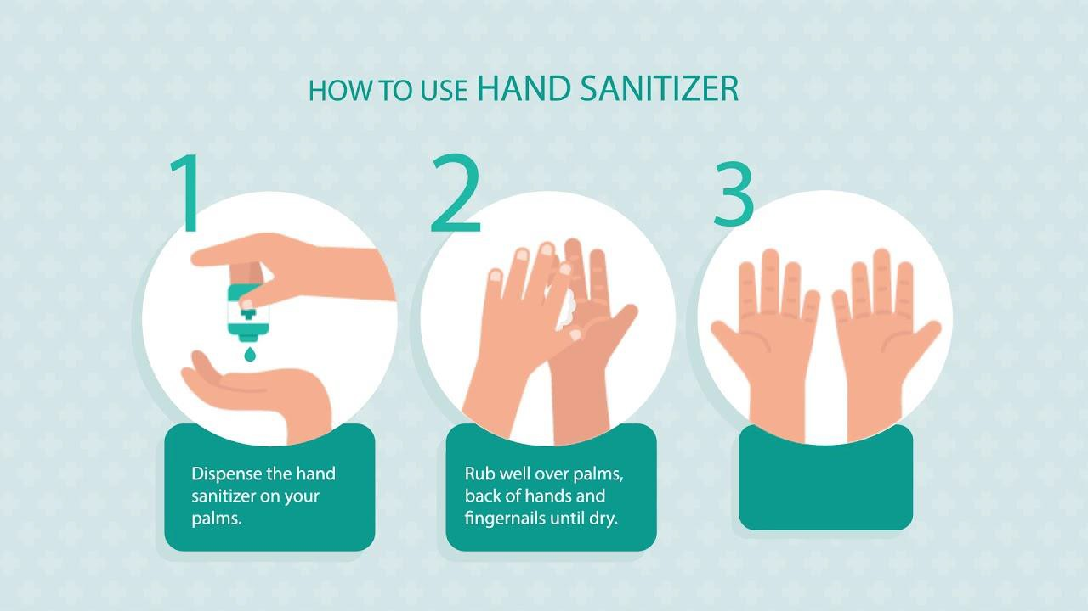
How to use hand sanitizer

Slide 16
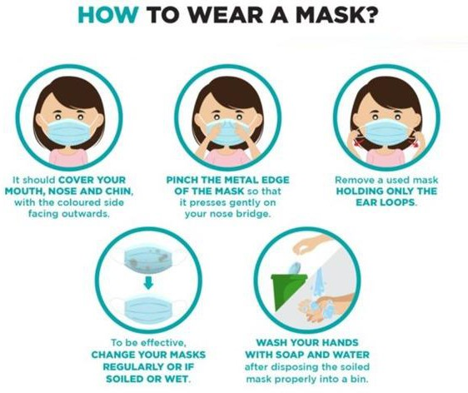
How to wear a mask

Slide 17
Compliance Enforcement
Coaches are to be the role models for the skaters and their
parents.
Maintaining social distancing where possible, ensuring all required forms are filled out correctly in advance of taking the ice and following all hand washing and hygiene practices.
All individuals must comply with the most current version of the Return to Play protocols established by the Grande Prairie Skating Club and Skate Canada: Alberta-NWT/Nunavut and must adhere to all federal, provincial, and municipal regulations. Non-compliance may result in removal from training sessions without a refund.
If the guidelines set by Skate Canada: Alberta-NWT/Nunavut and AHS are not followed, Grande Prairie Skating Club could be shut down.
If any coach, skater or parent is found to be non compliant with the guidelines set by Skate Canada: Alberta- NWT/Nunavut and AHS, they will be asked to leave or not permitted into the facility.
The Assumption of Risk and Waiver form must be completed by each participant (including staff, skaters, coaches, and volunteers) prior to participation in any activities. Arrive at the arena with it filled out.

Slide 18
The best form of communication between the club and
the coaches is email.
Communication
The role of the coach with regard to communication with the skater is as follows:
Ensure schedule is clearly communicated.
Make sure the skater knows when to enter and exit the facility, where to be during ice resurfaces and how music will be played.
The skaters must maintain social distancing requirements and practice safe hygiene/respiratory practices, the coach will ensure this takes place.

Slide 19
If your skater develops COVID-19 symptoms, or is required to isolate due to close contact, your account will be credited for any unused sessions once the Club receives a copy of the notification letter from your school or health authority.
Cancellation and Refund Policy
If the GPSC or Coke Centre or Alberta Health Services cancels programming due to an outbreak of COVID-19, your account will be credited for any unused sessions.
Let’s stay safe together!

Slide 20
STAY SAFE

